Slide 1

Learn to Code: Python
Timothy Hoang
June 24th, 2021
For OS Solutions Team

Slide 2
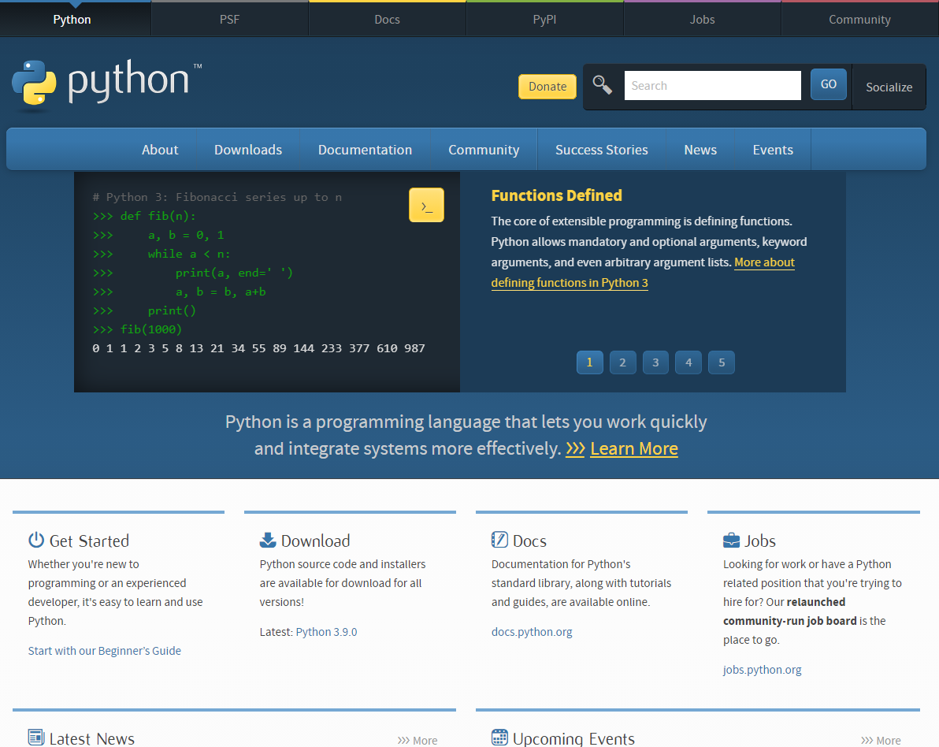
Presentation Layout
python.org
What is Python & Syntax
Why learn Python
Python & Other Languages
Running Python
Basic Syntax
Python Strings
Python Functions
Python Classes
Starting OOP Concepts
Resources
Action Steps
Closing

Slide 3
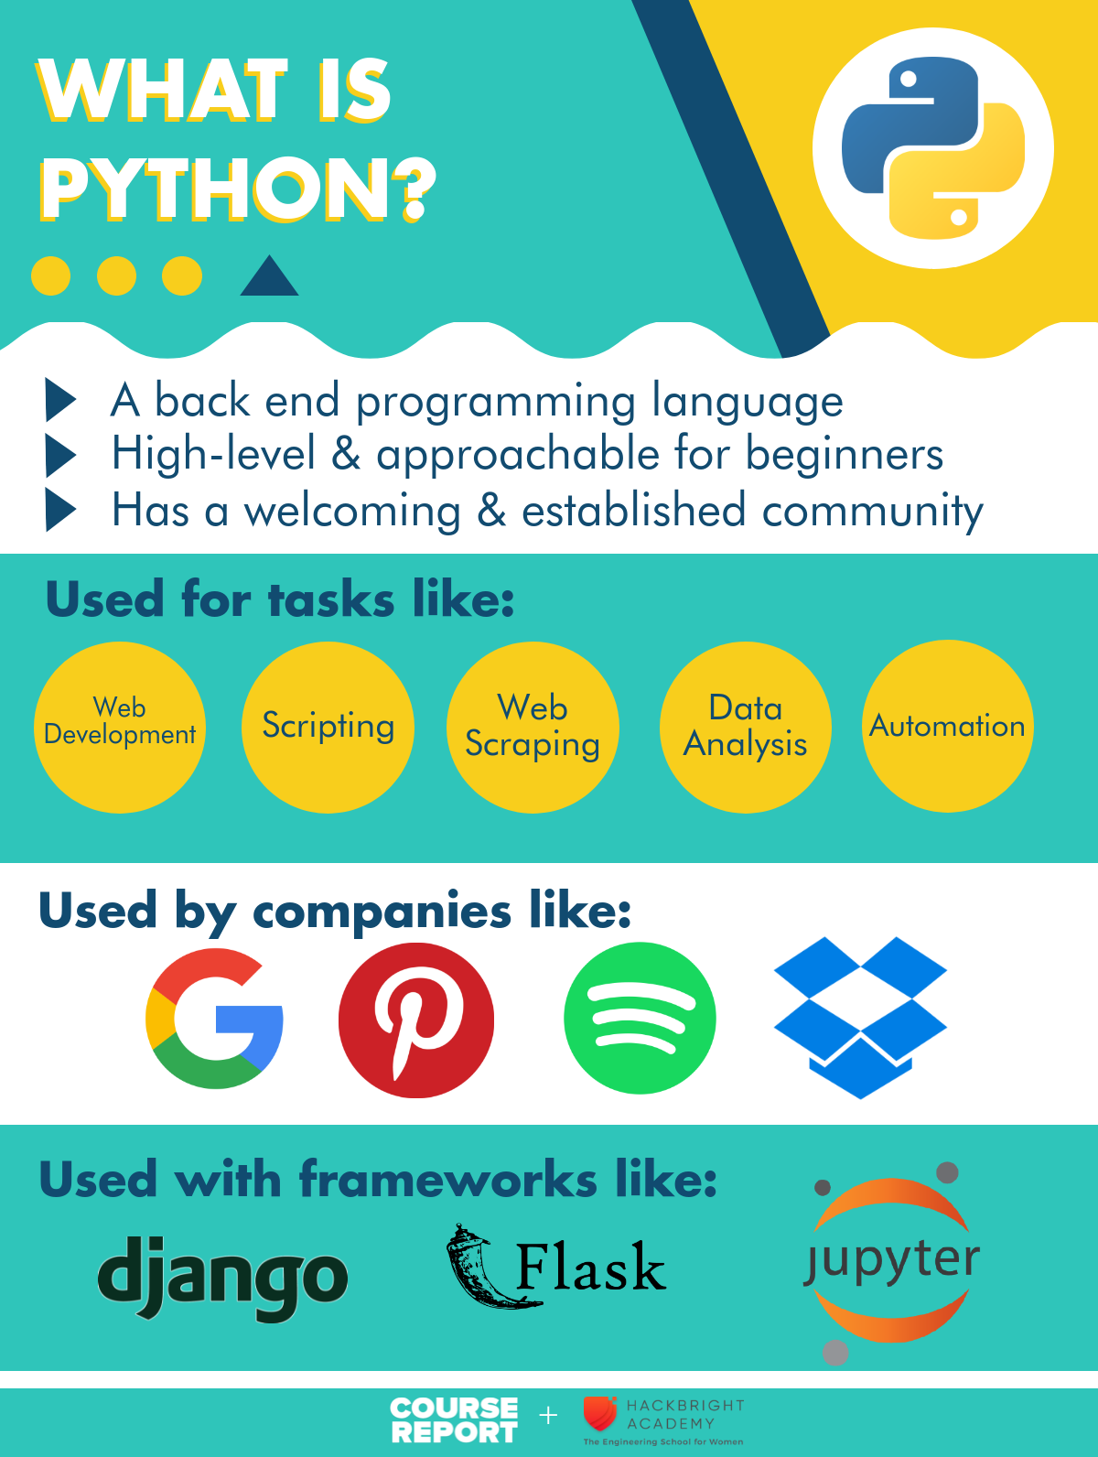

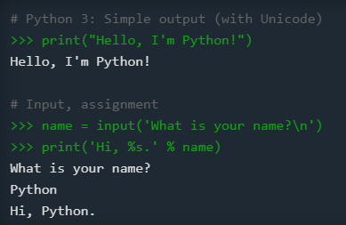
What is Python
Object oriented, back-end language
Simple language for rapid development
Released in 1991 by Guido van Rossum
Name from being “a big fan of Monty Python's Flying Circus”
Most recent version is Python 3
Python 2 is still popular, end of life on 1/1/2020
wikipedia.org
python.org
coursereport.com

Slide 4
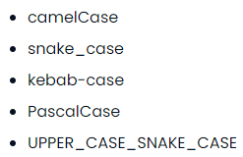
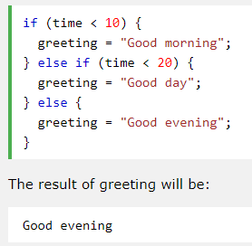
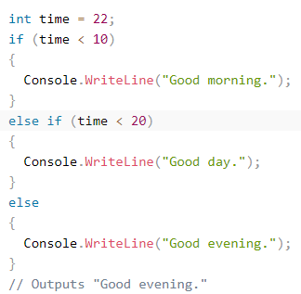
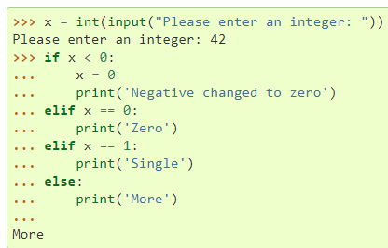
What is Python Syntax
Code structuring uses lines and indentation, instead of semicolon or parentheses
Focuses on object/classes, has members and methods
“Partial” OOP language with concepts like APIE (abstraction, polymorphism, inheritance, encapsulation)
Uses PEP-8 style guidelines and snake_case typing
chaseadams.io
Python
JavaScript
C#
docs.python.org
w3schools.com
w3schools.com

Slide 5

Why Learn Python
Simplicity, readability, and easy to learn (Zen of Python, use import this)
“Batteries included” language with large standard library
Supports modules for extensibility
Large community, established knowledge base, open-source
Used in web development, data analysis, scientific computing, machine/deep learning, internet of things
Works on many platforms (Windows, Mac, Linux, Raspberry Pi)
Supports many paradigms: procedural, object-oriented, or functional
Web Development Frameworks: Django (2005), Flask (2010)
Has garbage collection. Yay!
flask.palletsprojects.com

Slide 6
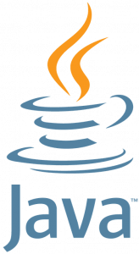
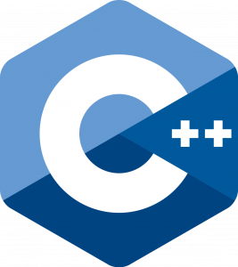
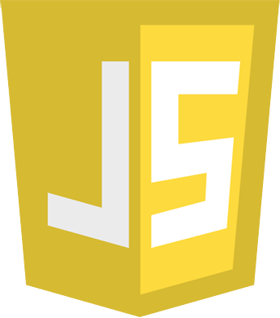
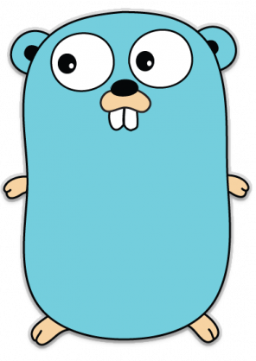
Top 5 Languages 2020 from hackr.io
Python and Other Languages
One of the more well-known languages
Use the language that best suits your purpose
Consider frameworks and libraries on top of these languages
Looking for a job? Google for top languages of <current year>
Web development? Try JavaScript (React, Node, Electron, React Native)
Game development? Try C++
Enterprise applications? Try Java or C#
Language closer to the hardware? Try C
Data Analysis/Machine Learning? Try R
Aiming for Google? Try GoLang
Blockchain/Cryptocurrency? Solidity, Plutus, Rust

Slide 7
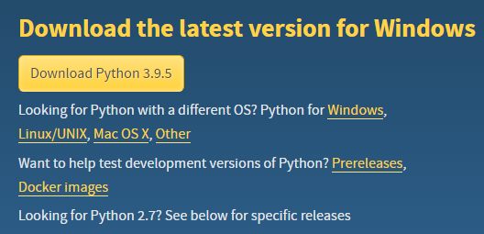
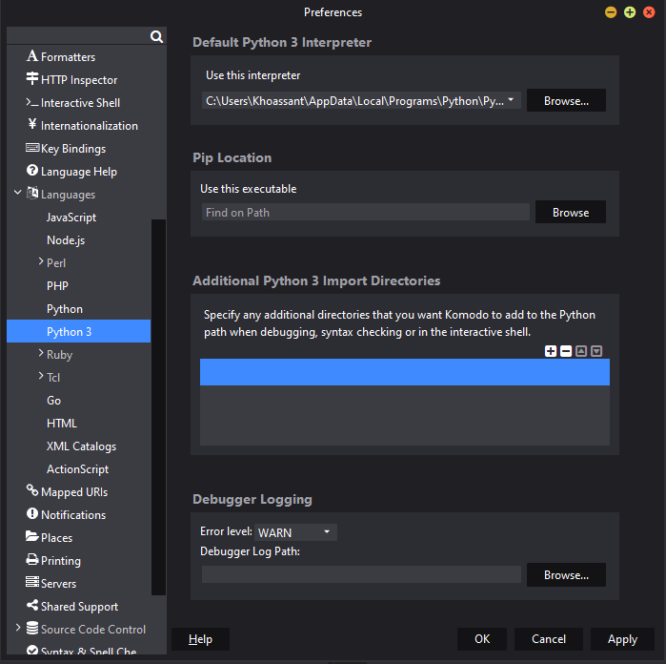
python.org
Running Python
Python 3.9.5
IDEs: Thonny, Komodo, and PyCharm
1.Downloaded Python 3.9.5 for Windows
2.Downloaded Komodo IDE
3.Registered for free Active State account
4.Run Komodo and choose interpreter: python.exe
5.Run python in the terminal
6.Check out the Python Docs and Resources
Choosing Komodo debugger
docs.activestate.com

Slide 8
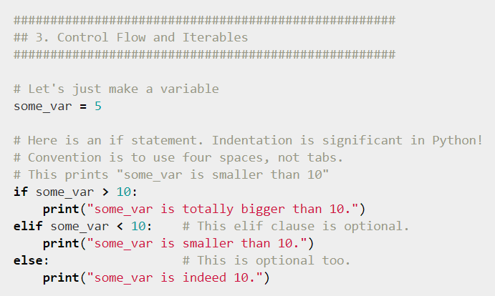
Running commands
7.Try Py terminal commands
py - runs the py terminal
import this - runs the Zen of Python
Shift enters makes a new line
Enter submits a line
exit() - exits the py terminal
cls - clears the windows terminal
Try an if-elif-else loop
Try a li = [] (list) and use li.append(), len(li), li.pop() and looping through a list
Try importing the math module (import math) and use math.pi, math.ceil, math.floor
8. Use X in Y Minutes to learn more language syntax
learnxinyminutes.com

Slide 9
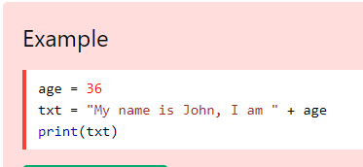
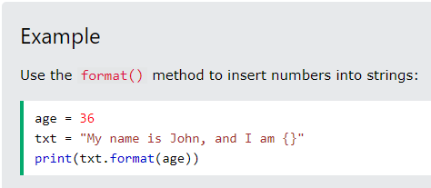
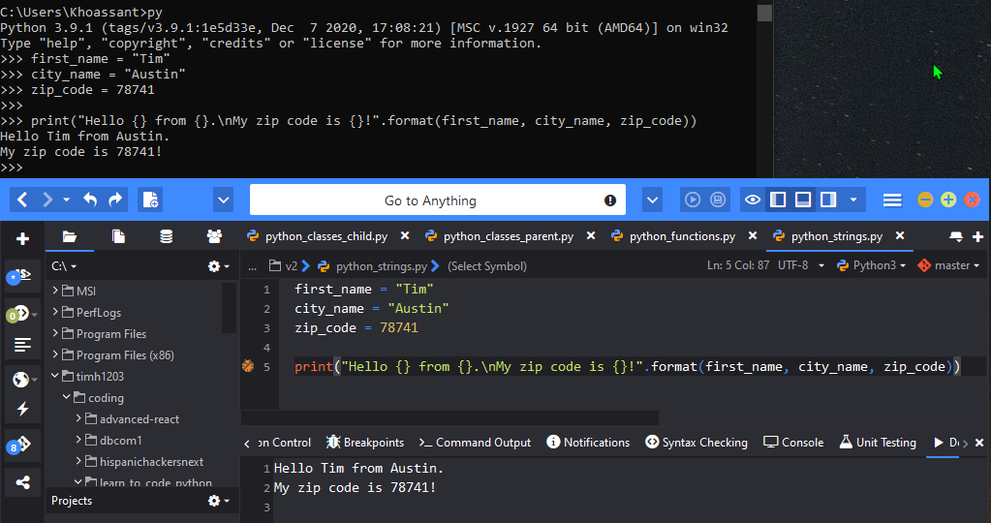
Code Example #1: Strings
Strings display info and helps with debugging
Old way to write strings (line 5)
“\n” is a line break. (line 5)
Single quotes vs Double Quotes?
No specific standard.
Single quote – keys or one word
Double Quote – interpolation or sentence
Triple Quote – raw html or documentation
Terminal introduction
Komodo introduction
See github repo for code
Tip: Can’t add numbers to strings unless you use .format()

Slide 10
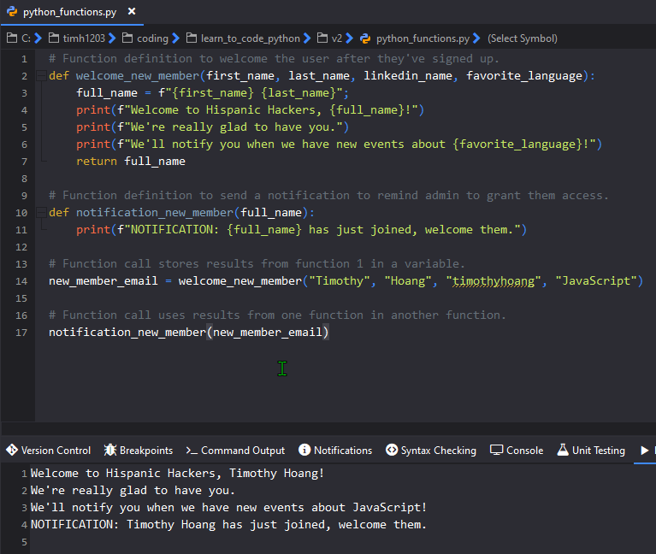
Code Example #2: Functions
Imagine a backend app...
Welcome new members
Send admin a reminder
Store member name in variable to use in reminder function and possibly grant permissions
Definitions declarations (2,10)
Definition calls (14,17)
Tip: F-strings or formatted string literals is an easier way to write strings. (lines 4, 5, 6, 11)

Slide 11
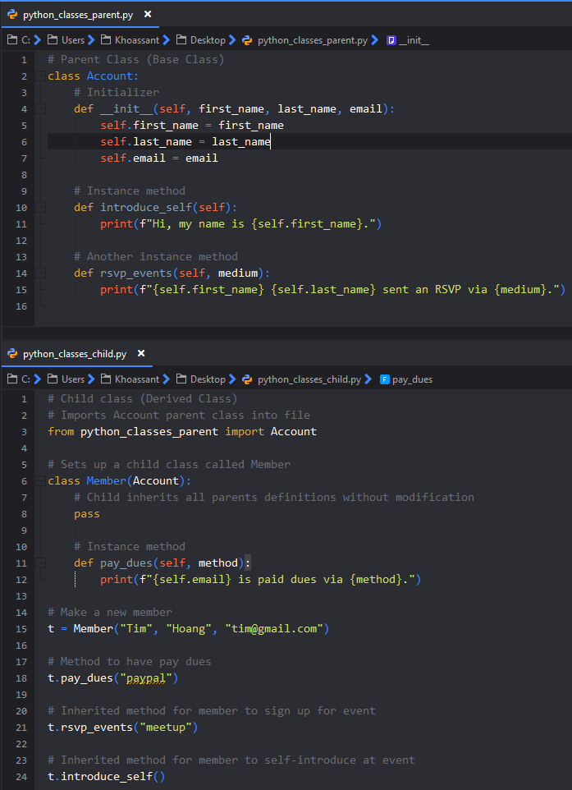
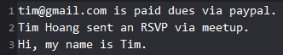
Code Example #3: Classes
Use Inheritance when working with classes
Set up a parent class called Account
Properties: first_name, last_name, email
Methods: introduce_self, rsvp_events
Set up a child class called Member
Receives all properties and methods from parent
Use pass to inherit without modification
Own method: pay_dues
Results:

Slide 12
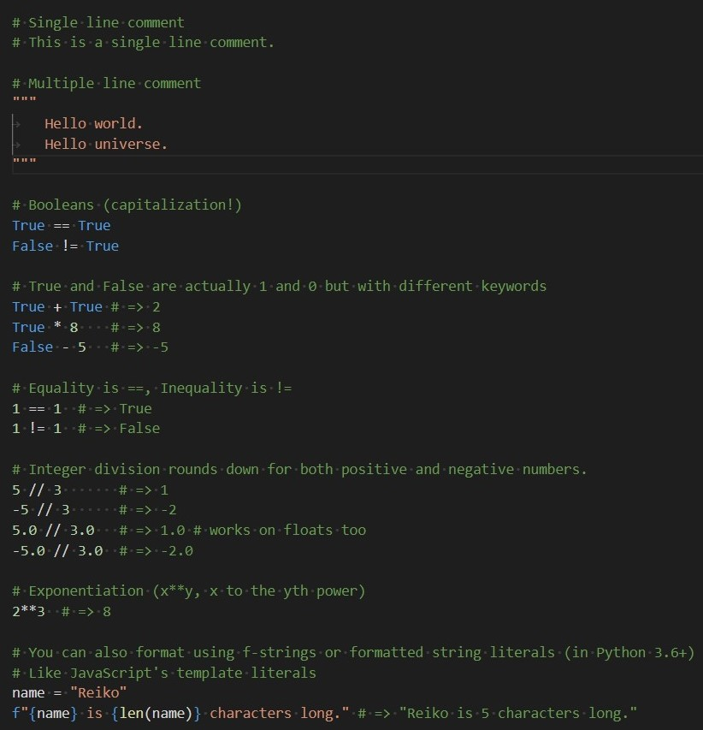
More Python Syntax
Common usage
Single line comments
Multi line comments
Booleans True & False capitalized
Math Operations with True and False
Comparison operator, no triple equals
Round down division
Exponents
F-strings or formatted string literals

Slide 13
More syntax and data structures
0, “”, [], {}, () - falsy values
None – is a object
"yay!" if 0 > 1 else "nay!" # => "nay!" - ternary operator
Statically typed python?
Python 3.5+ has type hints
mypy (static type checker)
Cython (compiles Python to C)
4 data structures:
Lists – array
Dictionaries – object
Tuples – immutable arrays
Sets – Looks similar to dictionaries

Slide 14
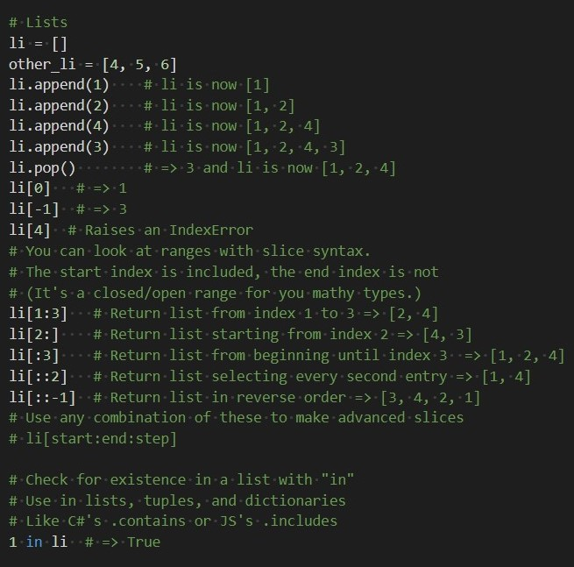
Lists
Arrays-like

Slide 15
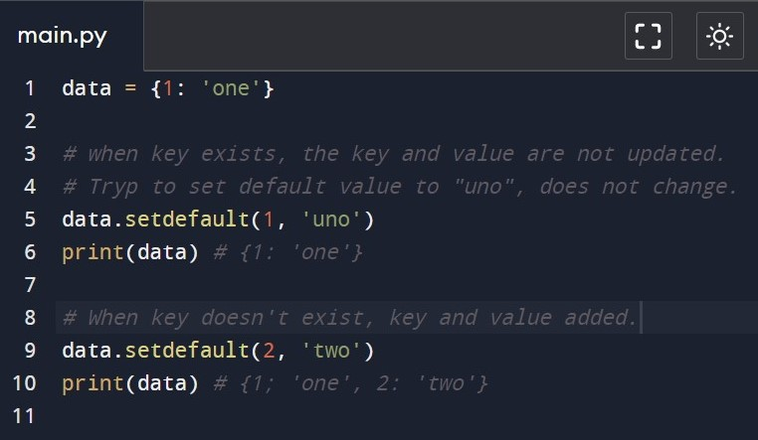
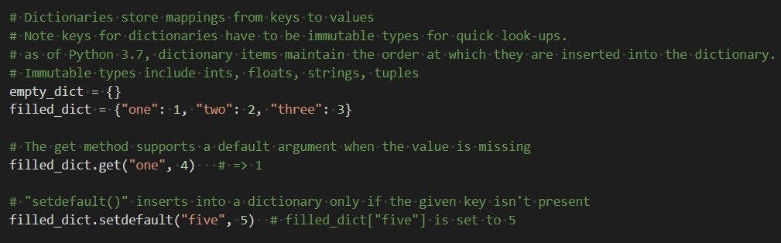
Dictionaries
Object-like
3.7, insertion order maintained
.keys() - like JS Object.keys()
.values() - like JS Object.values()
No JavaScript’s Object.Entries()
.get()
.setdefault() – does it update existing value? No, see example right.
1 in filled_dict - JS includes() or C# contains()

Slide 16
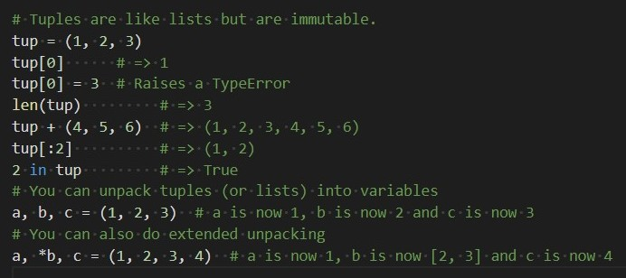
Tuples
immutable arrays

Slide 17
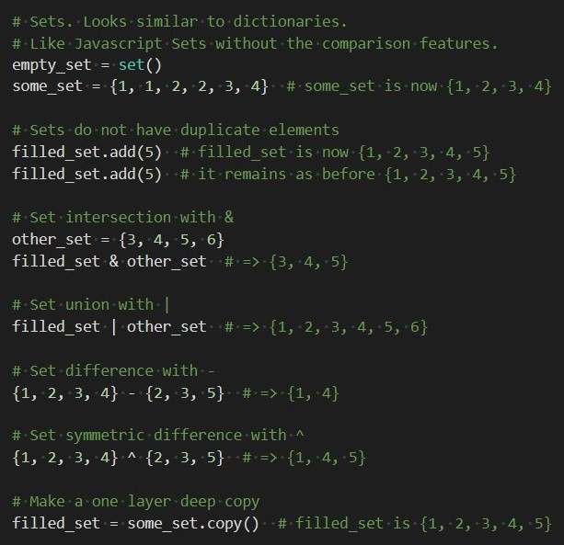

Set
Javascript’s ES6 Set or Weakset
No duplicate elements
intersection (&)
unions (|)
difference (-)
symmetric difference (^)
Syntax looks like to dictionaries

Slide 18
Intermediate Python Syntax
Classes
Class attribute – shared by all instances of the class
@classmethod – shared among all instances
@staticmethod – called without a class or instance reference
@property – property getter
@age.setter – property setter
@age.delete – property removal
super() – Access parent class methods overridden by the child
Inheritance
Multiple Inheritance

Slide 19
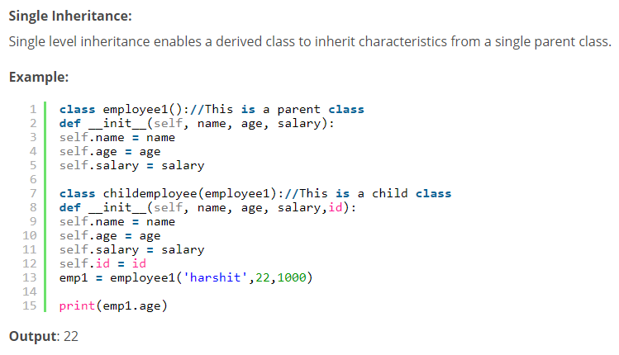
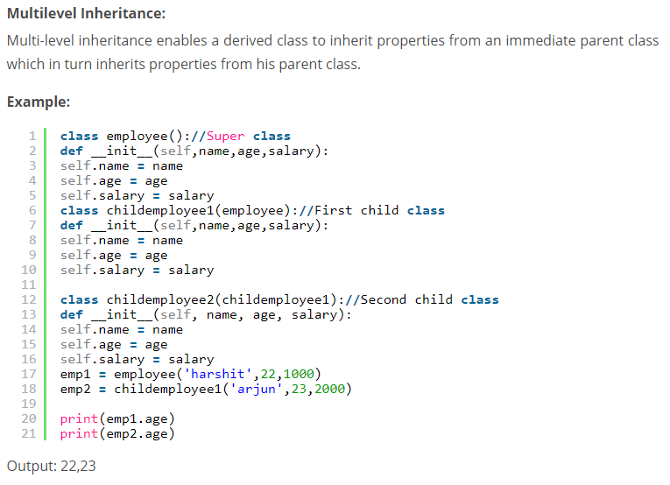
Getting into OOP Concepts
Use OOP concepts in Python
Why is Python not fully OOP?
Because does not support strong encapsulation
A PIE mnemonic Abstraction, Polymorphism, Inheritance, Encapsulation
Python has single and a variety of inheritance
Multilevel Inheritance Gparent => Parent => Child
Hierarchical Inheritance Parent => Siblings
Multiple Inheritance Dad & Mom => Child
Edureka.co

Slide 20
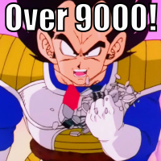


Getting into OOP Concepts
Polymorphism
Methods under the same name
Compile-time, static polymorphism, method overloading
Run-time/dynamic polymorphism, method overriding
Overloading - different objects can have different fxn’s with same name but with different parameters
Overriding – inherited function from base class is “replaced”
Encapsulation
Restricting access outside a class
No private keyword in Python but can use __ (dunder)
Abstraction
Can’t create class, for inheriting functionalities only
You’re not ready for this one!!!

Slide 21
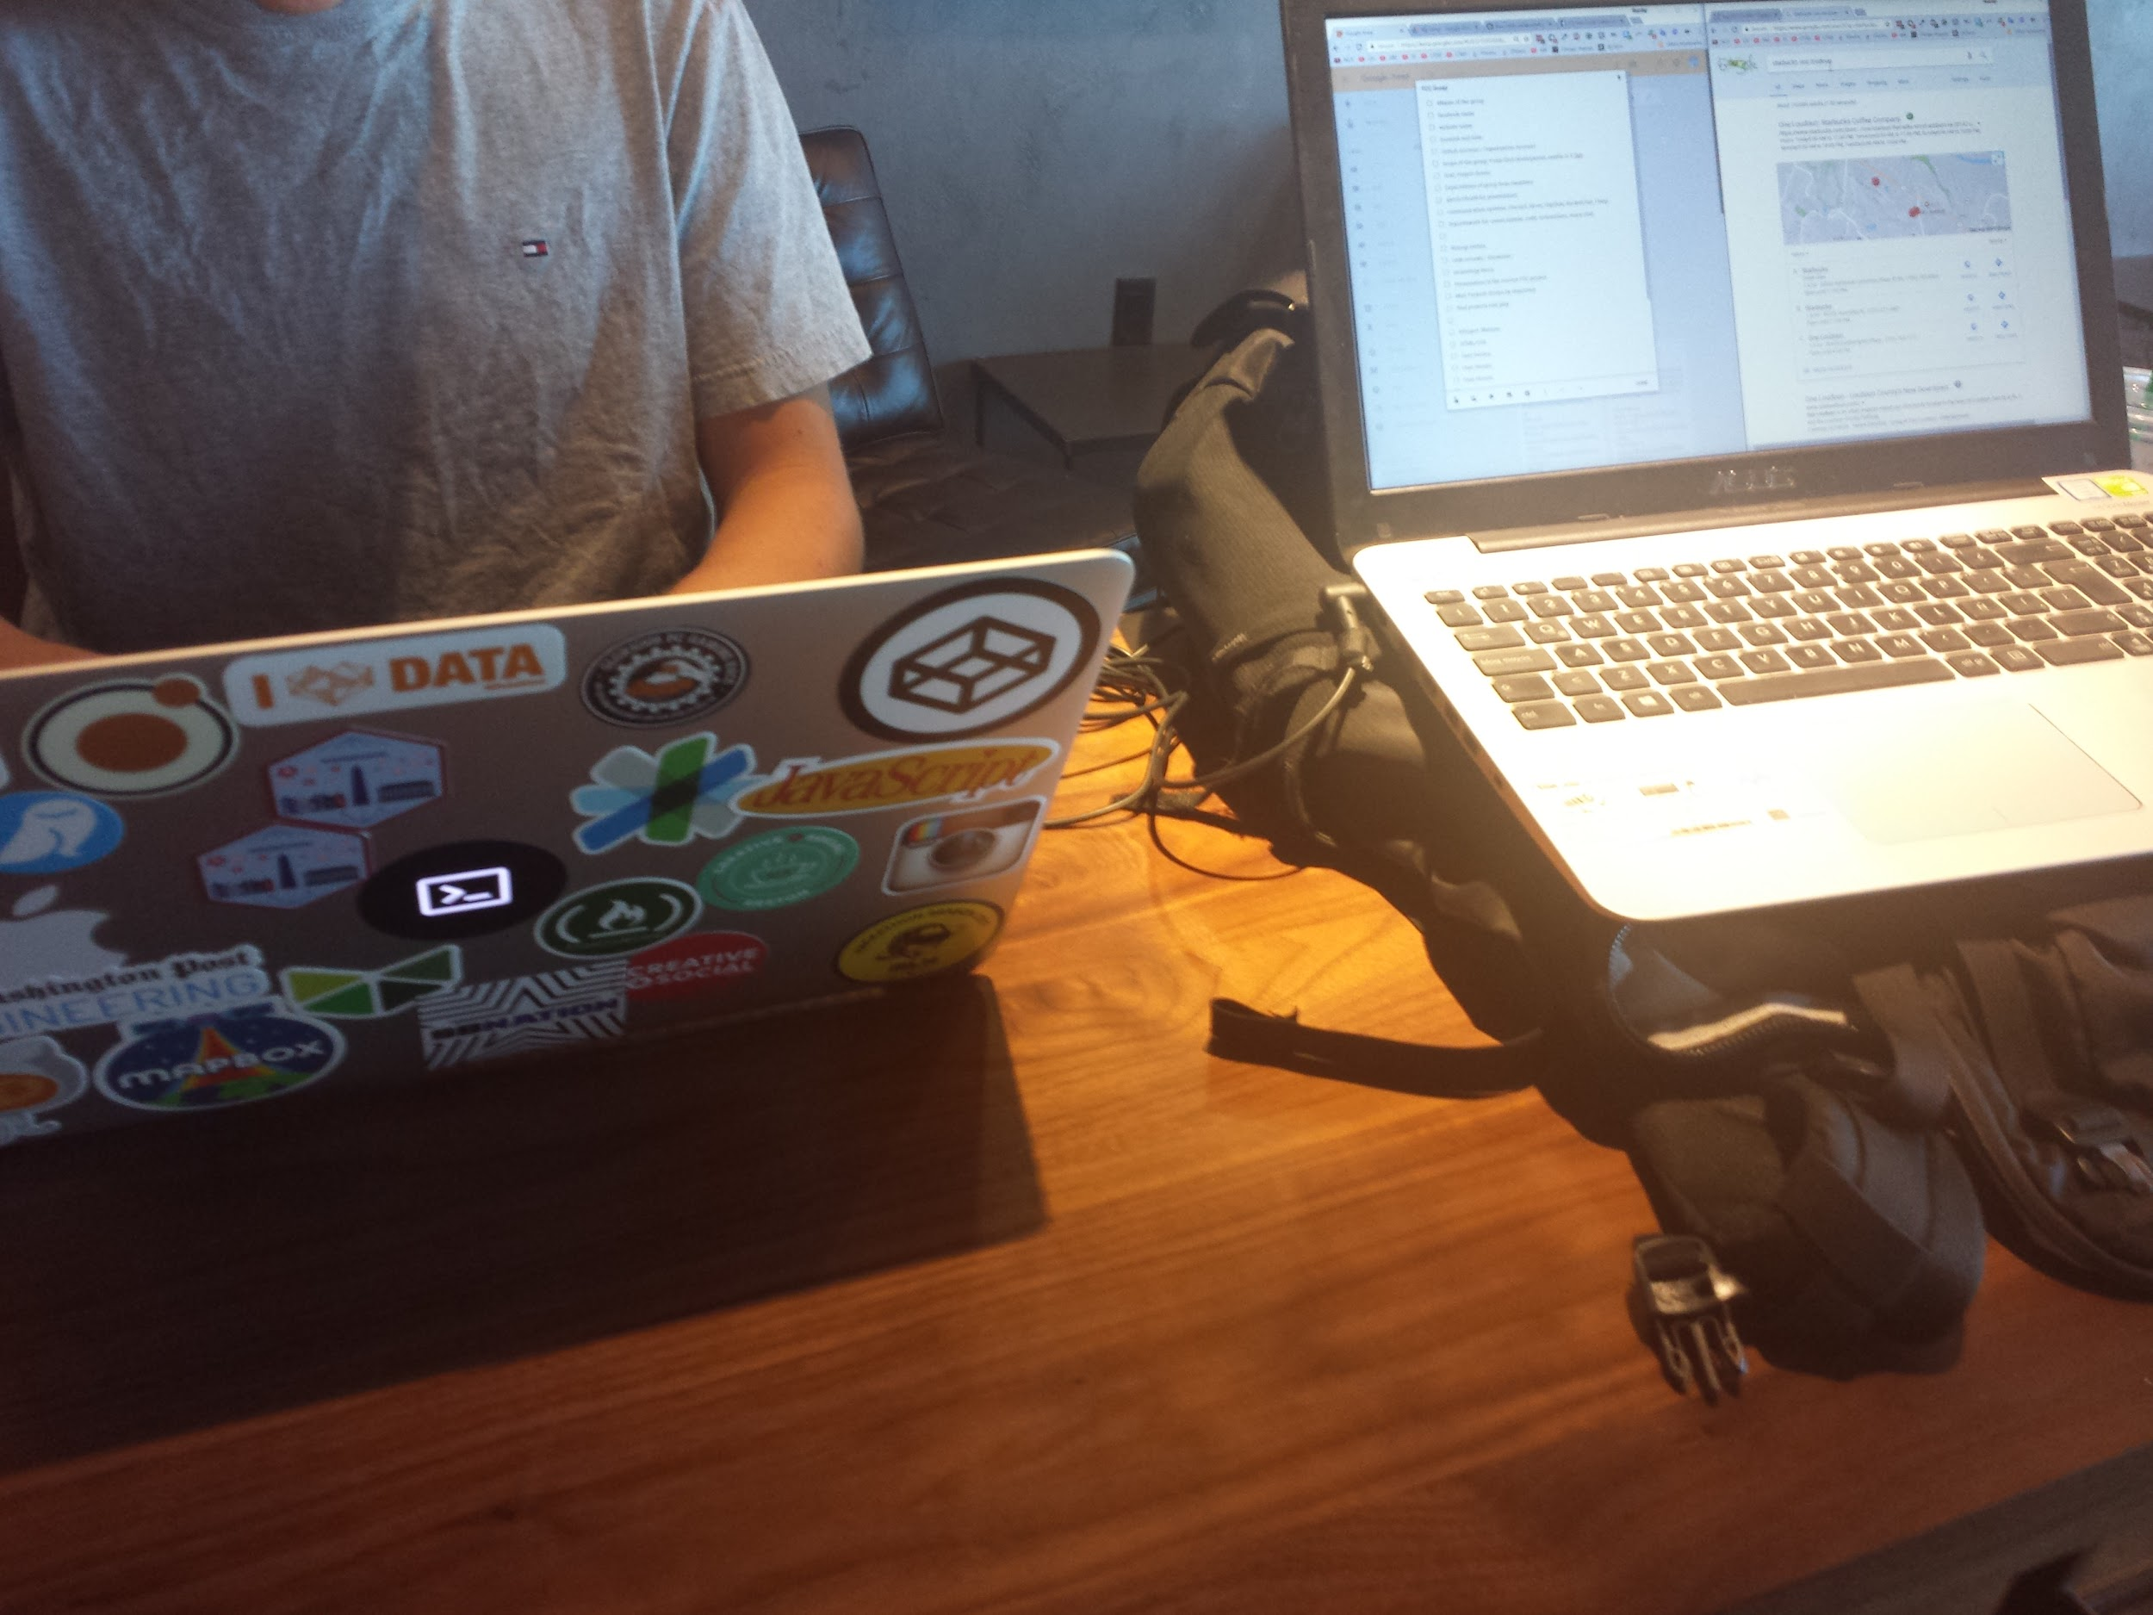
Resources
Official Python Home
Austin Python Meetup
Python Ecosystem 2020
LearnX https://learnxinyminutes.com/docs/python/
Edureka https://www.edureka.co/blog/object-oriented-programming-python/#Inheritance
Classes, List comprehensions, modules, CSV file reading - https://github.com/timh1203/lsw16v-sprintChallengeIntroPython
6 Algorithms - https://github.com/timh1203/lsw17i-ii-algorithms
BST, Doubly LL, Heap, LL, Queue - https://github.com/timh1203/lsw17iii-iv-dataStructures
Basic Django https://github.com/timh1203/lsw19i-ii-introDjango
Django Multi-User Dungeon (MUD) - https://github.com/timh1203/lsw20v-lambdaMUDProject

Slide 22

Sometimes it feels like...
Action Steps
Sign up for a free course
Google’s Python Class
Crash Course on Python by Google
Python 3 Programming Specialization by U of Michigan
Python for Everybody Specialization by U of Michigan
Set up your Integrated Development Environment (Thonny, Komodo, PyCharm)
Set up a github account and version control your code
Build toys and projects as you learn to add to your portfolio
Learn the language deeply, avoid coding polyglotism initially
Learn more tools in the ecosystem and take your skills to the moon

